Slide 1
Next: Lab

Slide 2

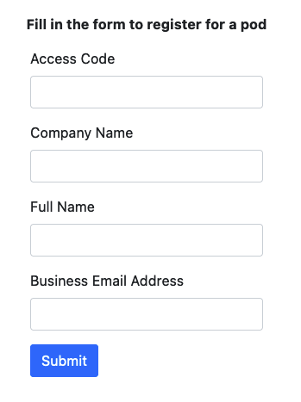
Lab Time – Access Code 54J9
Create Aviatrix ACE Academy Account: https://ace.aviatrix.com/
LAB POD Registration: https://portal.flightschool.aviatrixlab.com/
Spell your name exactly as you want it to appear on your ACE Associate certificate!
The attendees must insert the access code on the registration page and then fill in the form with their personal information. After that, they will land on their personal pod portal.
Fill the form with the required information.
Pay close attention to spell your Full name correctly, because this field will be used to populate your certificate
The Access Code is the same for all attendees and will be shared by the trainer
LAB Guide: https://docs.aviatrixlab.com/flightschool/docs/home.html (LAB1, 2 and 3 only)
Notes:
https://www.surveymonkey.com/r/aviatrixtraining
https://associate-lab-guide.ace.aviatrixlab.com/

Slide 3
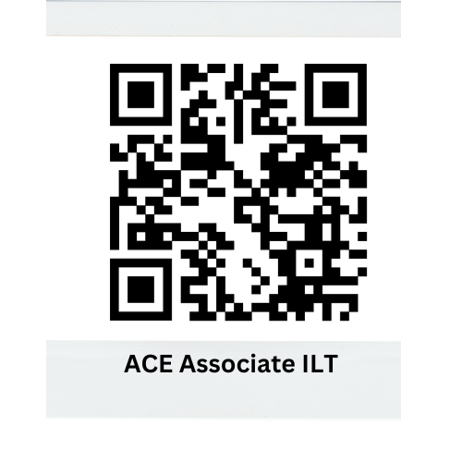
Survey (Mandatory Requirement to Get Certificate)
Your Feedback is important to us to shape our training and certification program
https://pages.aviatrix.com/associate-survey.html
Notes:
https://www.surveymonkey.com/r/aviatrixtraining
https://associate-lab-guide.ace.aviatrixlab.com/

Slide 4
Thank You!

